Slide 1
2019 Halloween Costume Contest

Slide 2
Saint Francis Departments

Slide 3
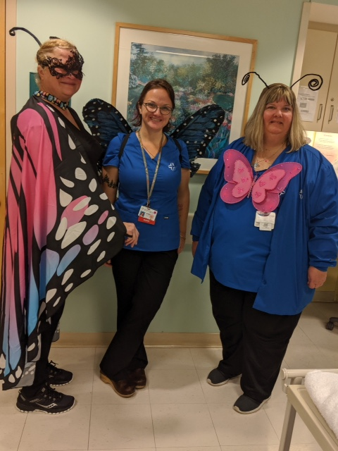
Maternal Fetal Medicine Department - SF

Slide 4
8-1 - SF

Slide 5
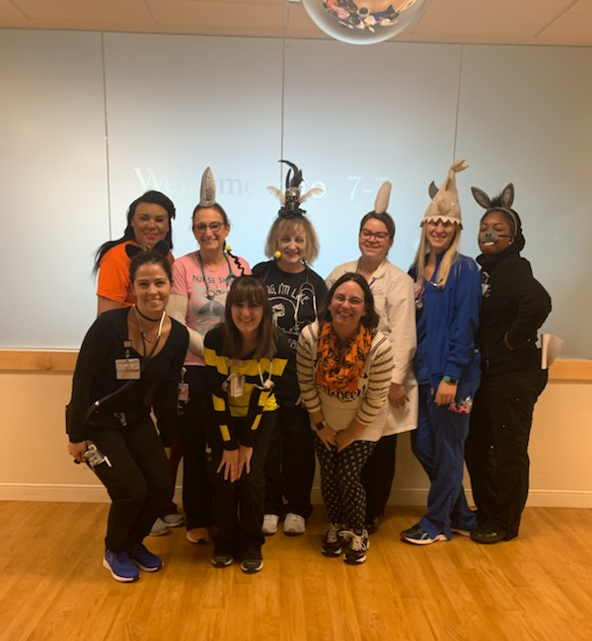
7-7 Colleagues - SF

Slide 6
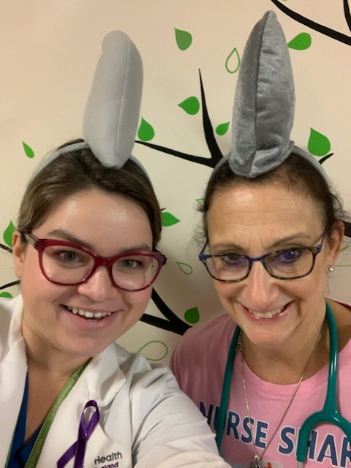
7-7 Colleagues - SF

Slide 7
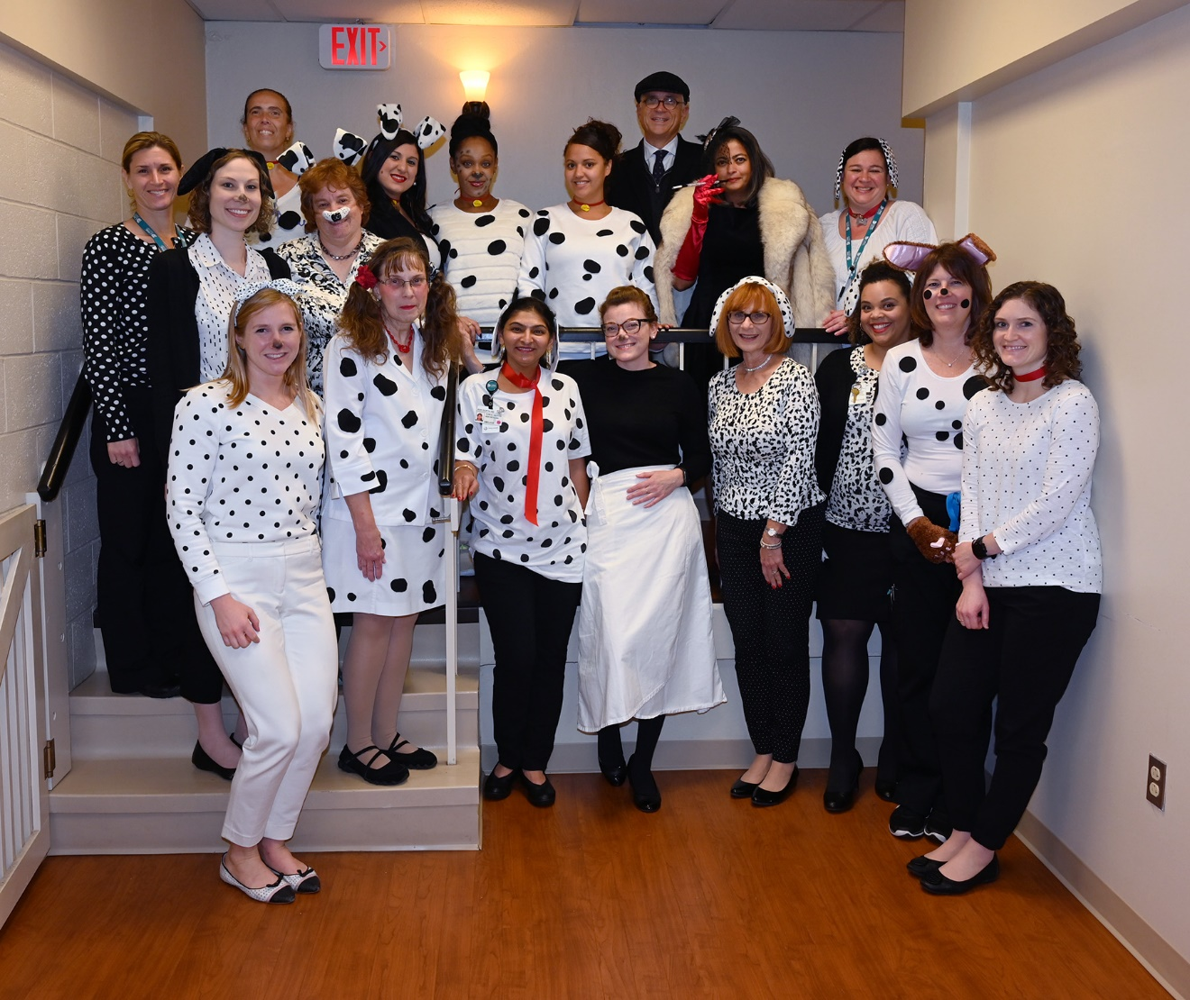
Diabetes - SF

Slide 8
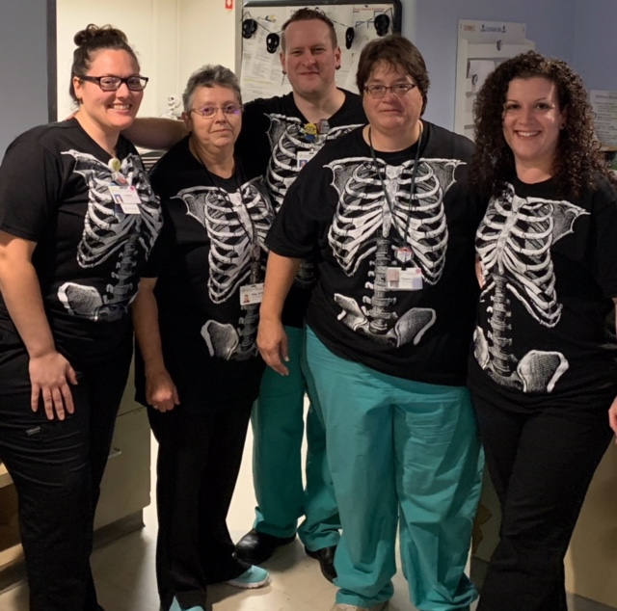
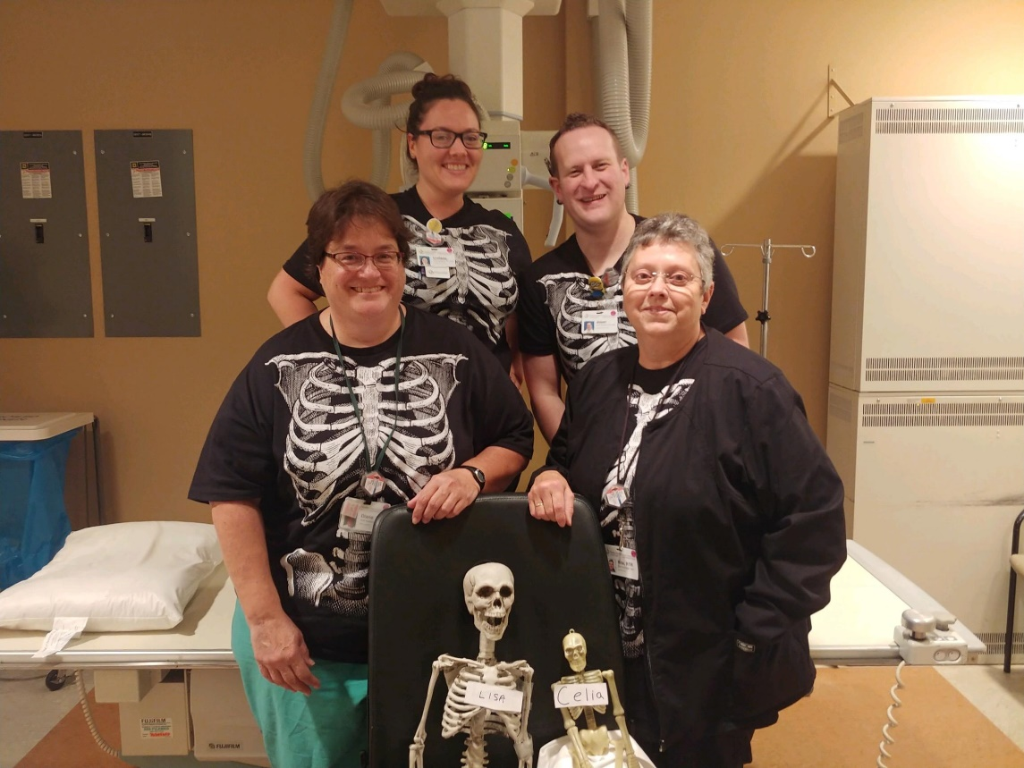
Radiology 1st & 2nd Shifts - SF

Slide 9
EPIC Informatics - SF

Slide 10
Engineering - SF

Slide 11
Case Management - SF

Slide 12
General Surgery - SF

Slide 13
Automated Data Lab - SF

Slide 14
MFM & Food & Nutrition - SF

Slide 15
Surgery - SF

Slide 16
OP Cancer Center - SF

Slide 17
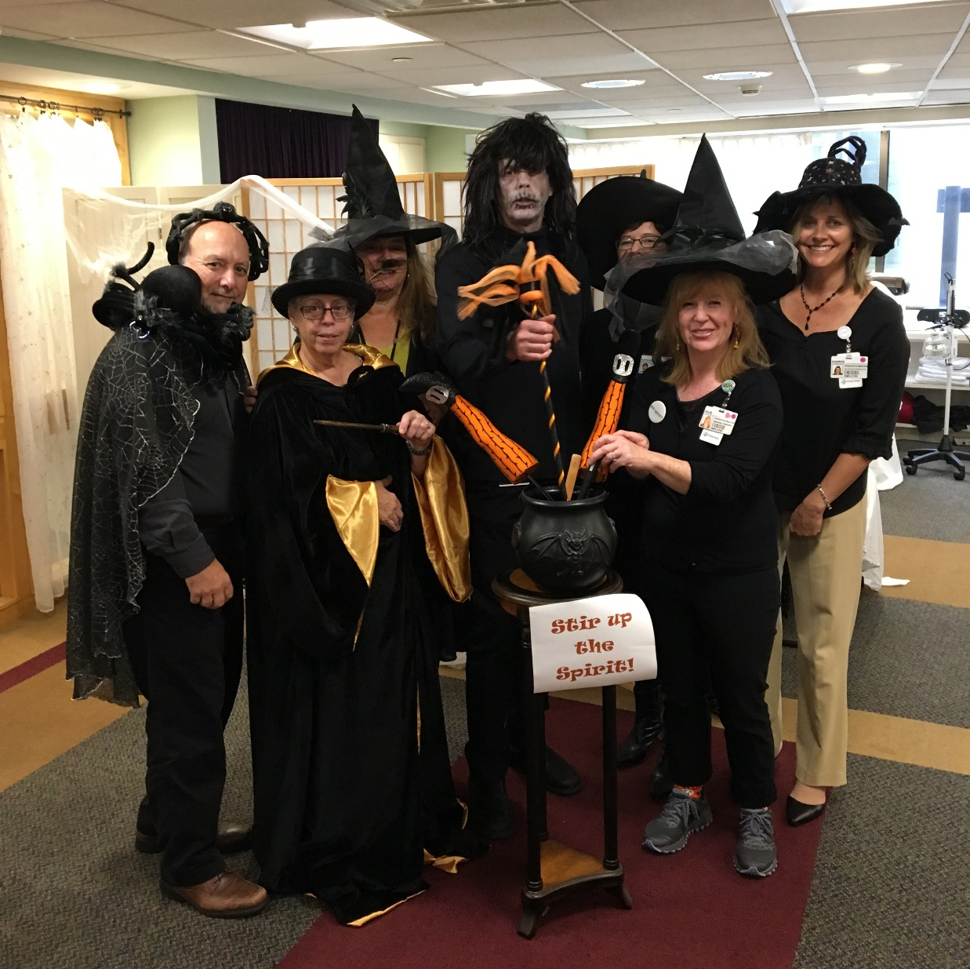
Integrative Medicine - SF

Slide 18
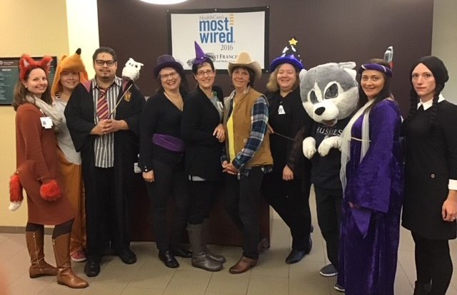
IT & Informatics - SF

Slide 19
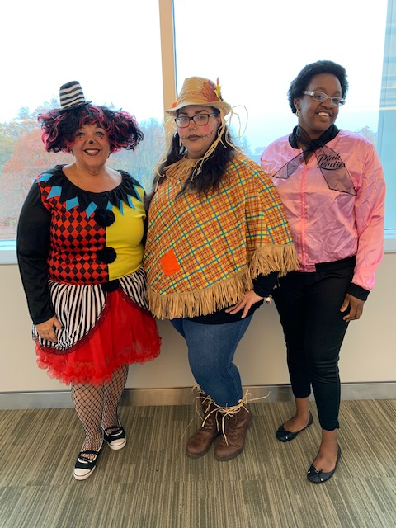
Patient Access - SF

Slide 20
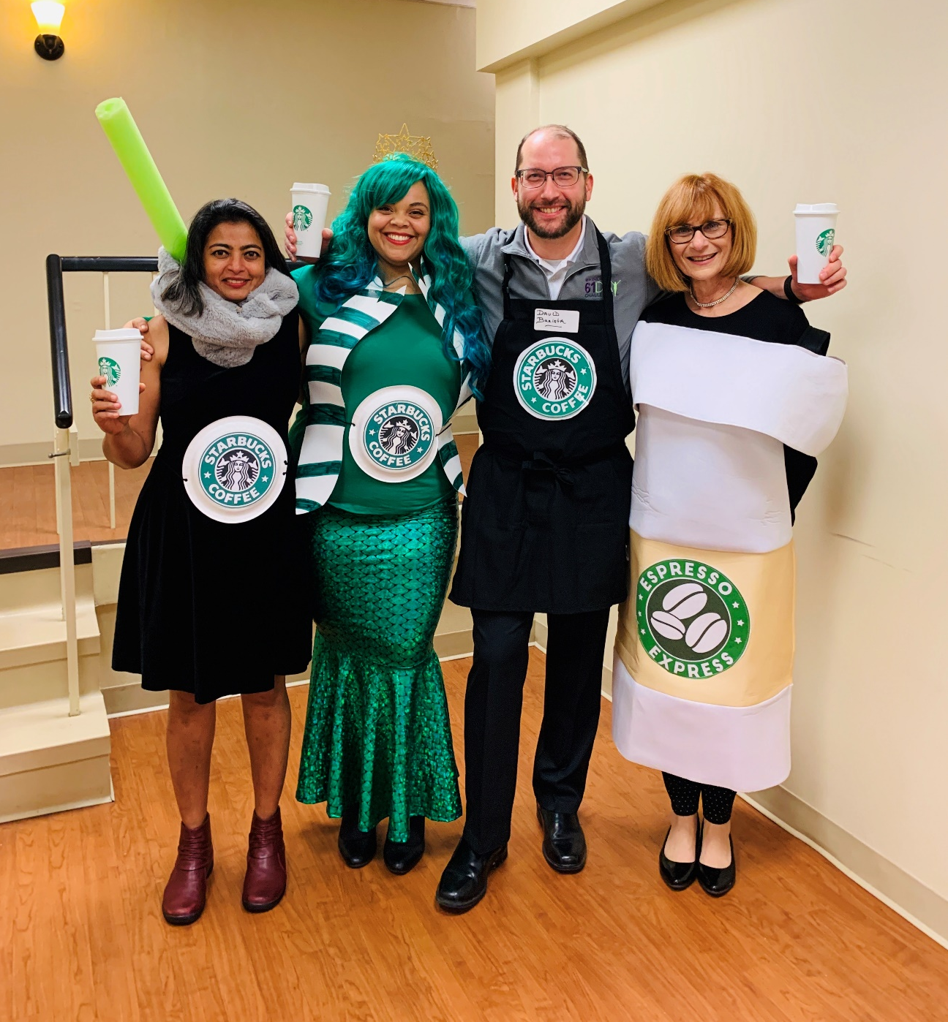
IRB - SF

Slide 21
Cancer Center - SF

Slide 22
No Prize – just for your enjoyment

Slide 23
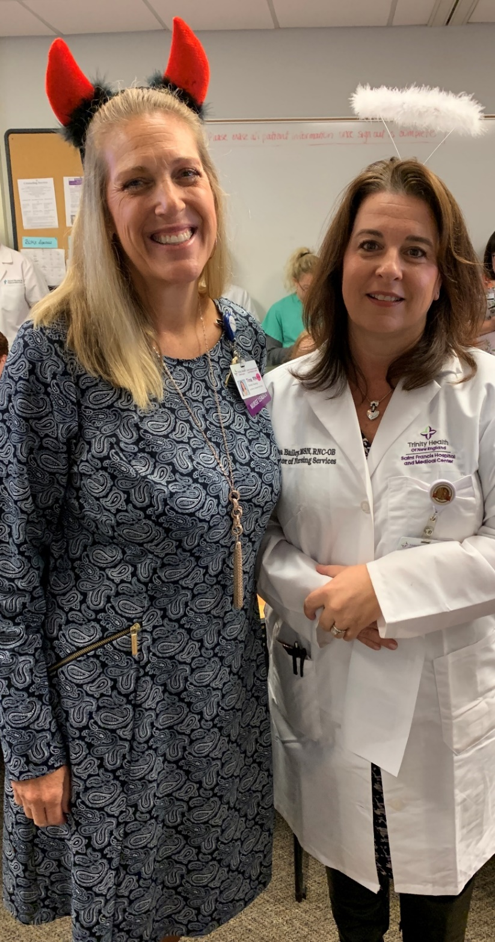
Nursing Directors- SF

Slide 24
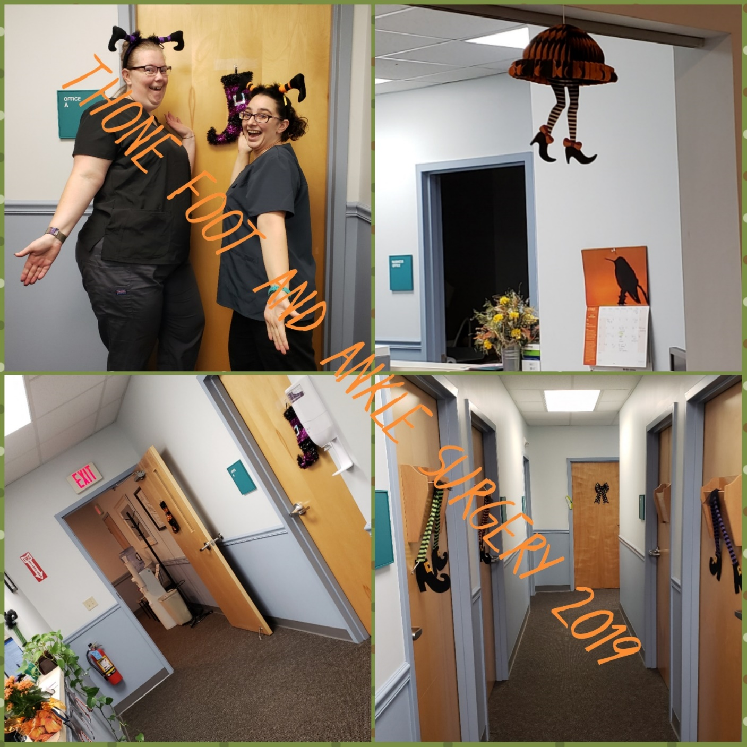
Foot & Ankle Surgery - SF

Slide 25
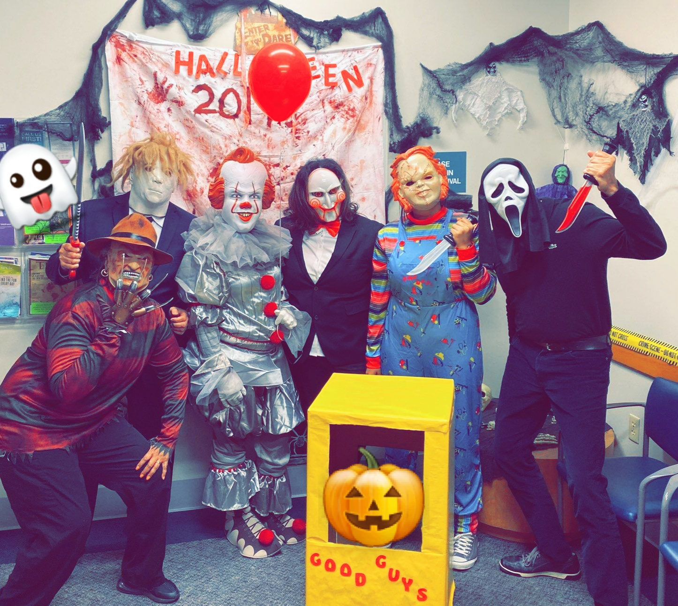
Collins Medical – Dr. Bechara and Dr. Wenceslao

Slide 26
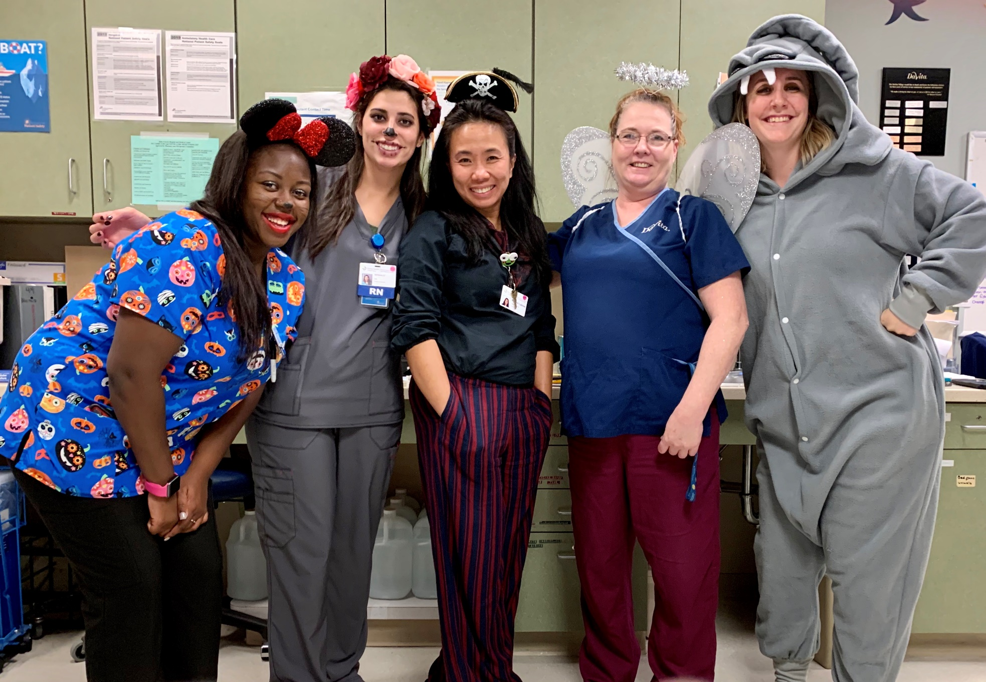
Dialysis SF

Slide 27
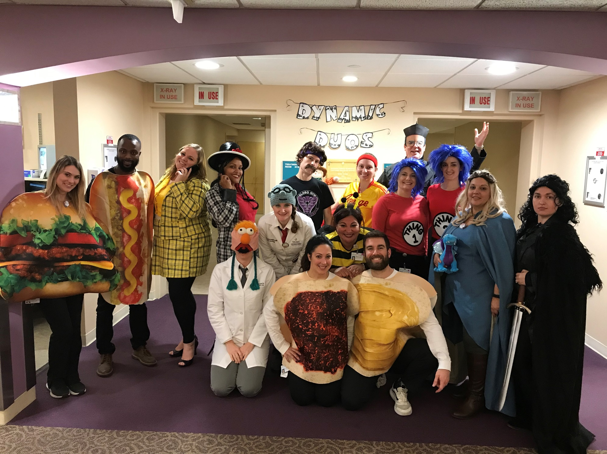
Radiation Oncology - SF

Slide 28
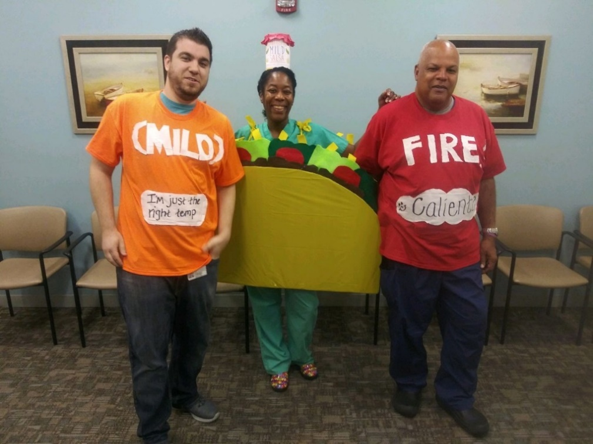
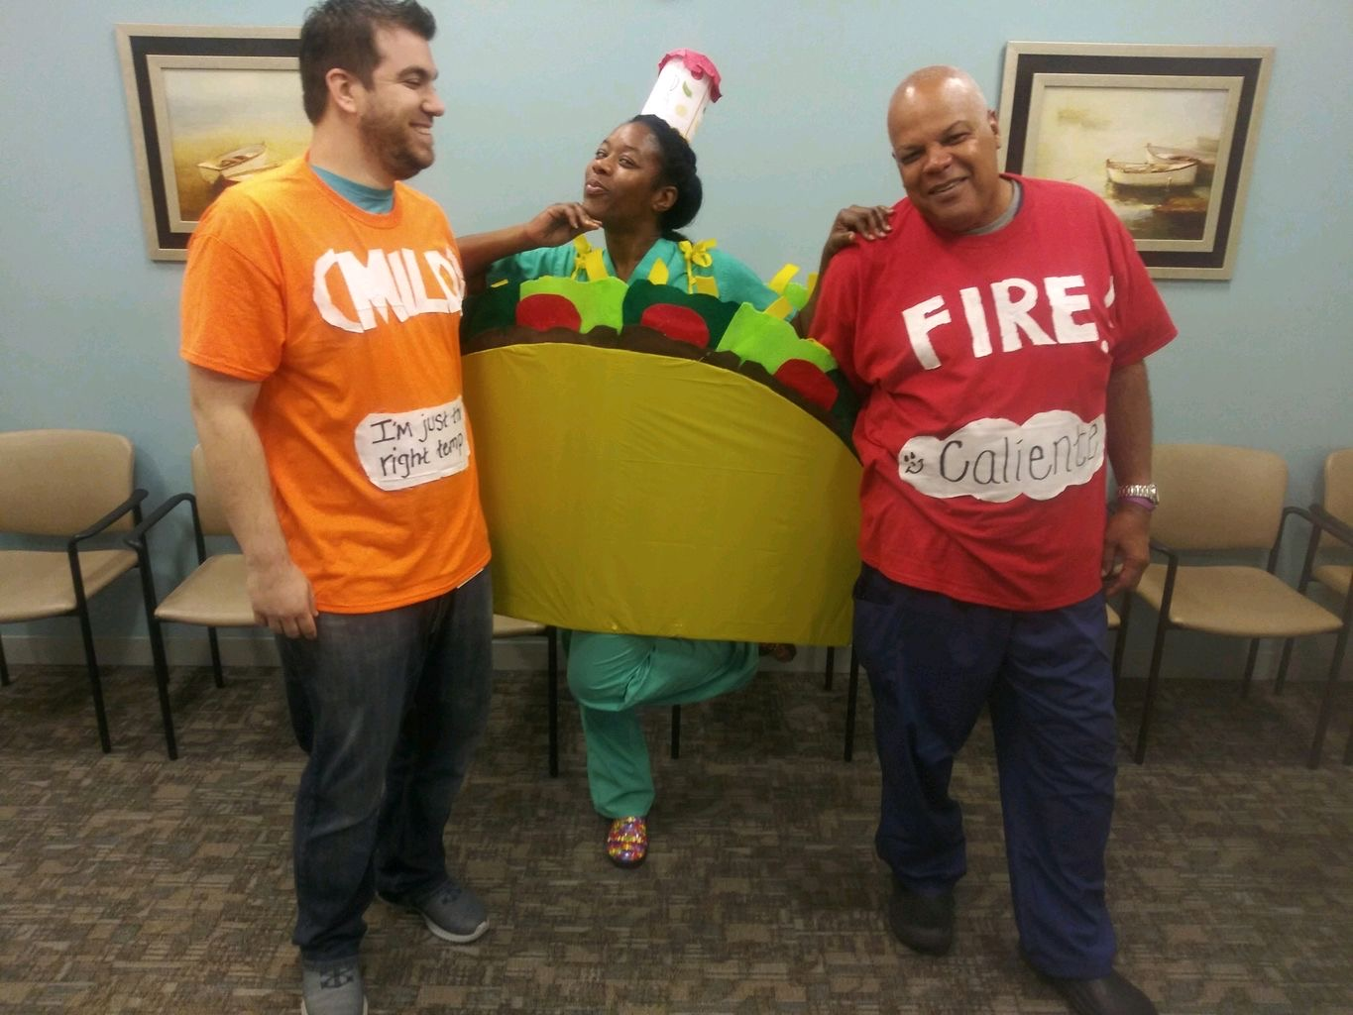
St. Francis/Trinity Health of NE Medical Group Orthopedic Trauma

Slide 29
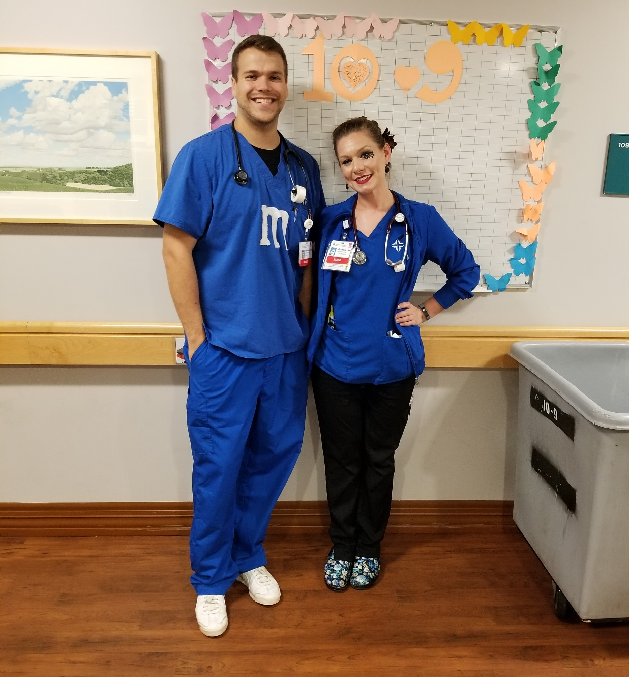
10-9 - SF

Slide 30
Mount Sinai Departments

Slide 31
Behavioral Health - MS

Slide 32
Johnson Memorial Departments

Slide 33
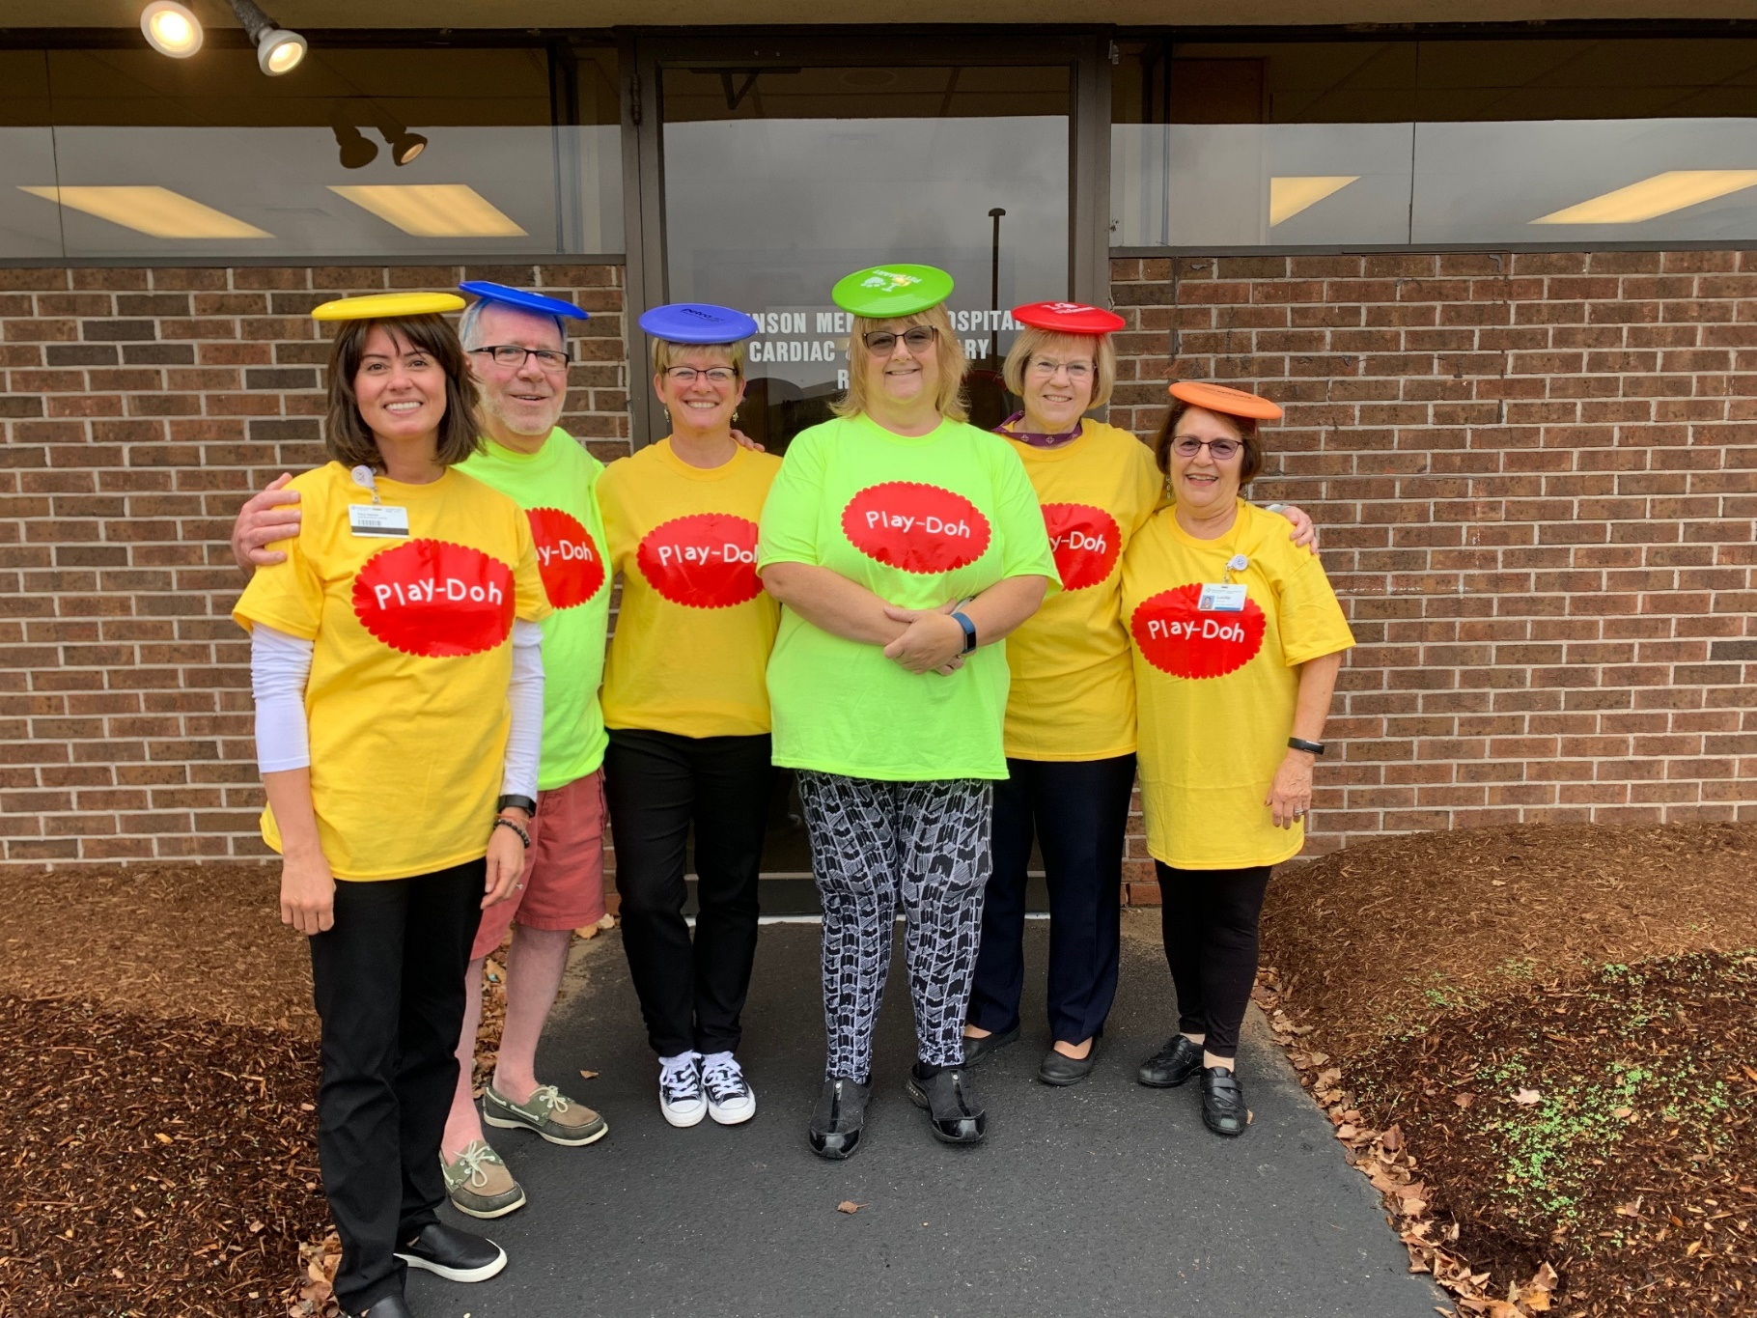
Cardiac & Pulmonary Rehab - JMH

Slide 34
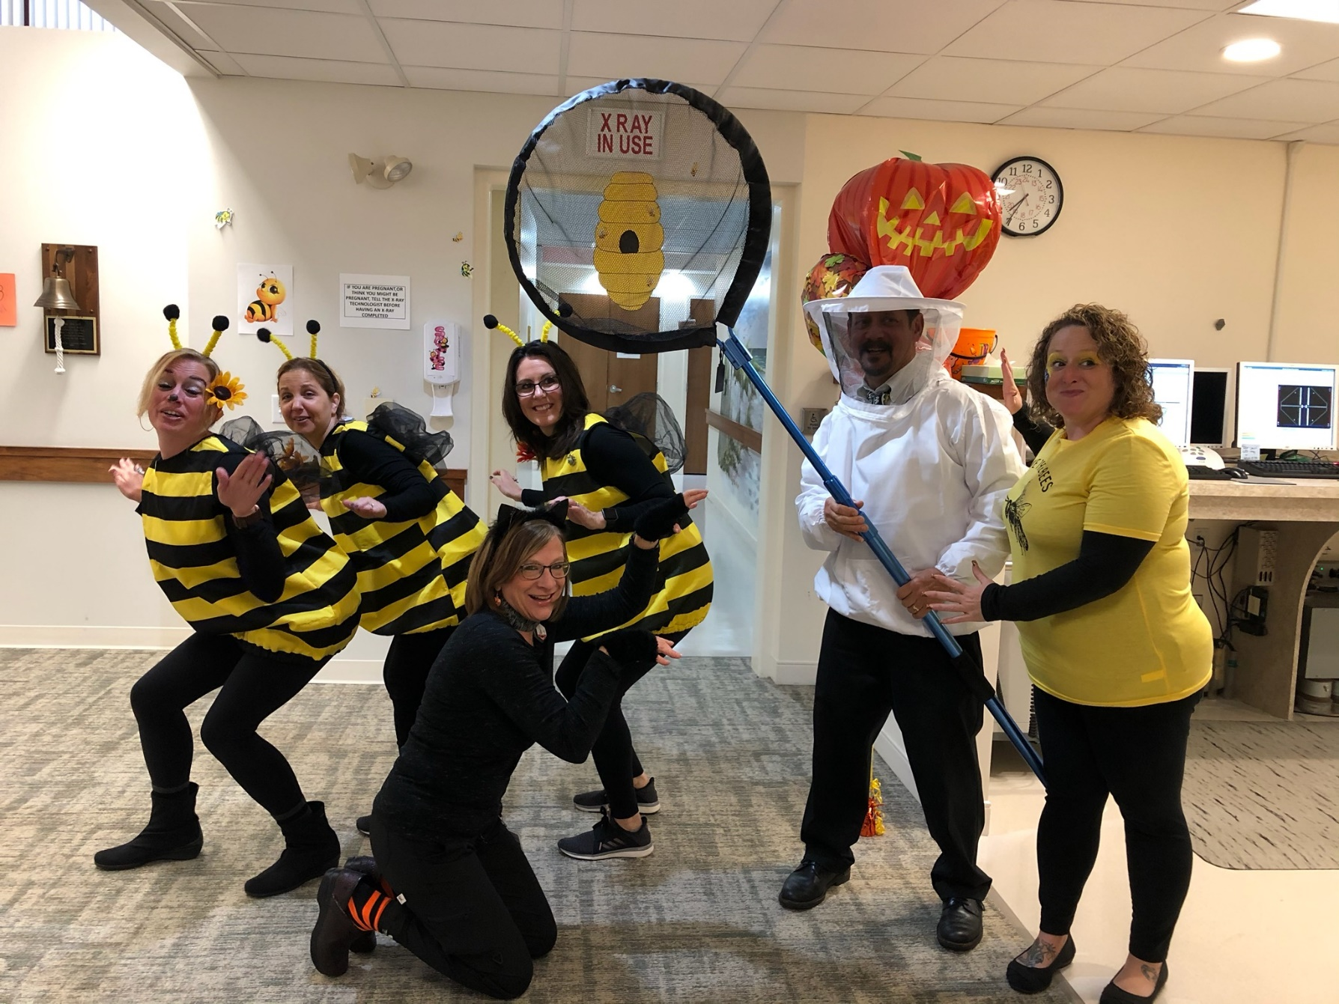
Radiation Oncology – JMH

Slide 35
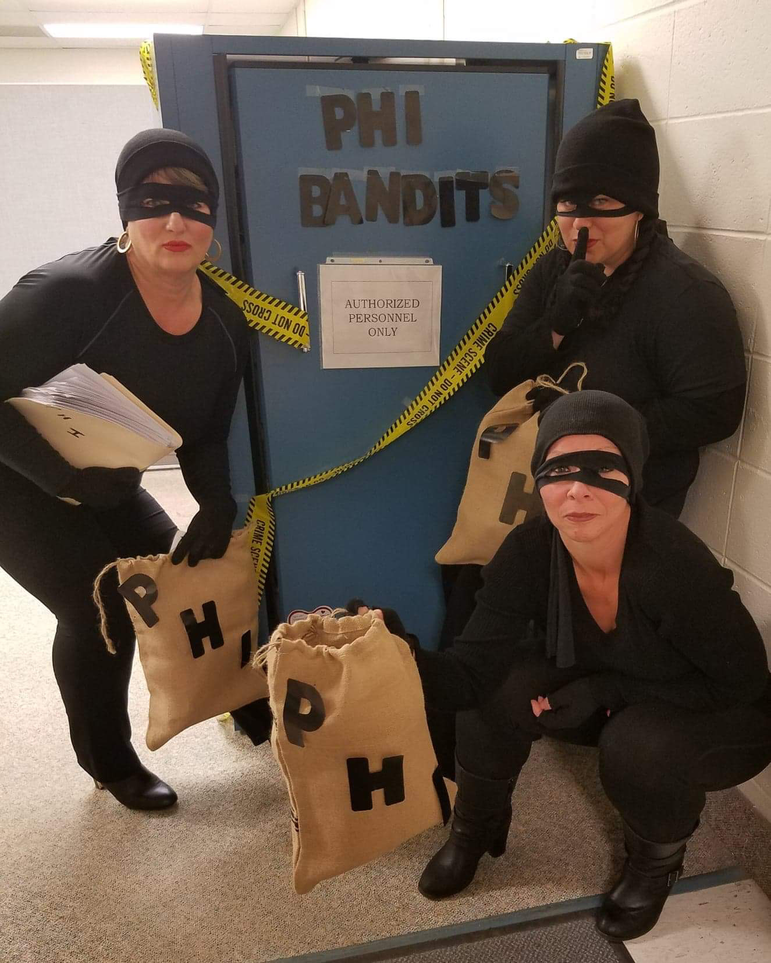
HIM - JMH

Slide 36
Saint Francis Individual

Slide 37
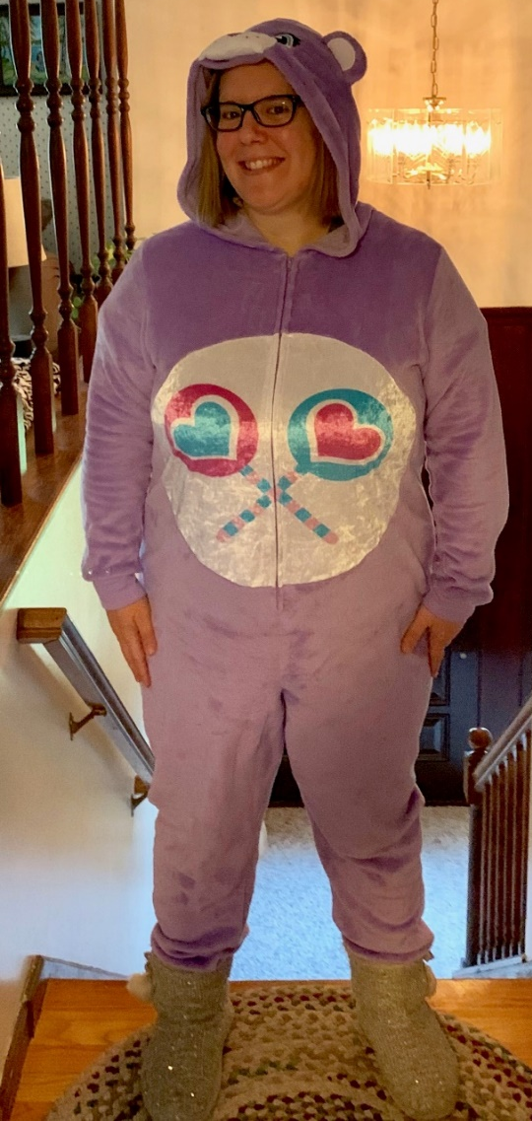
HIM - SF
Rebecca Ptak
Cheryl Grieco
Rick Adelkopf
Melissa Shain
Alicia Bird

Slide 38
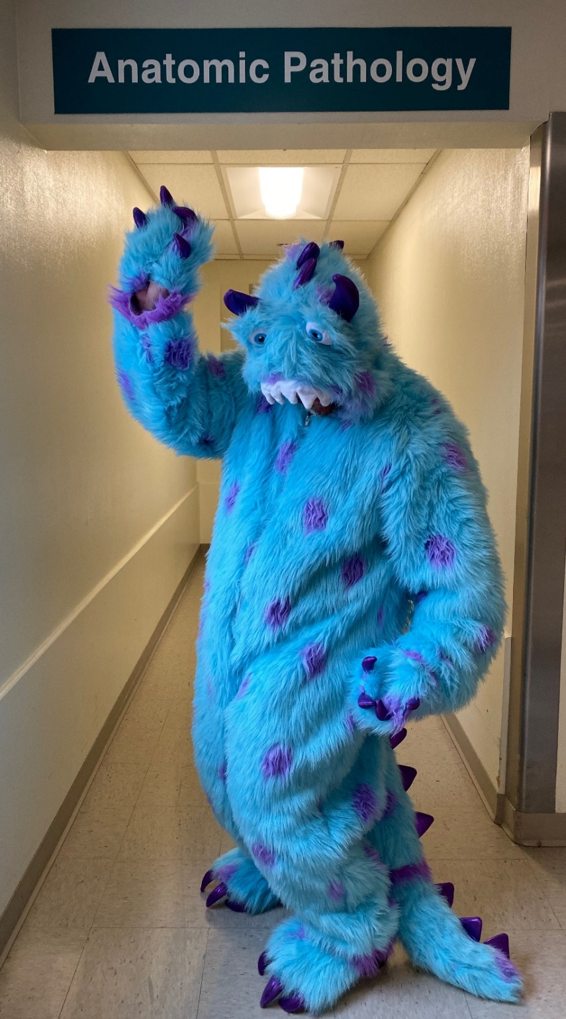
Pathology - SF

Slide 39
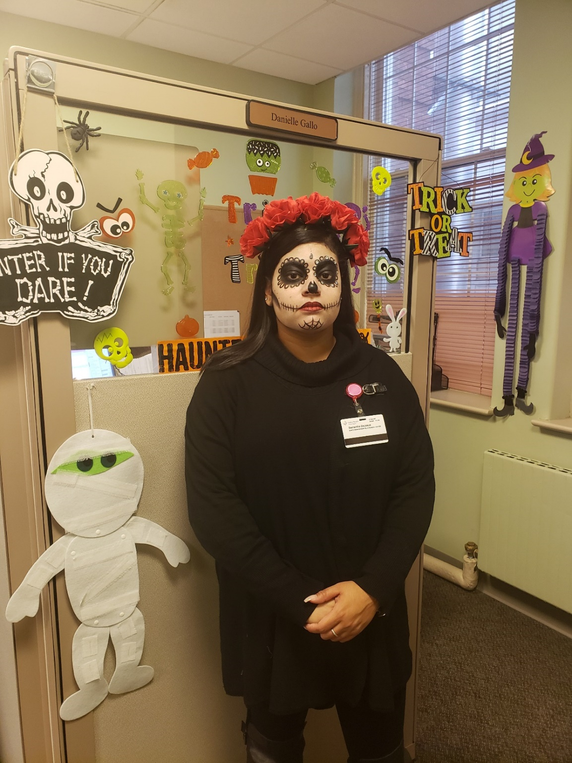
3-3 Anesthesia - SF

Slide 40
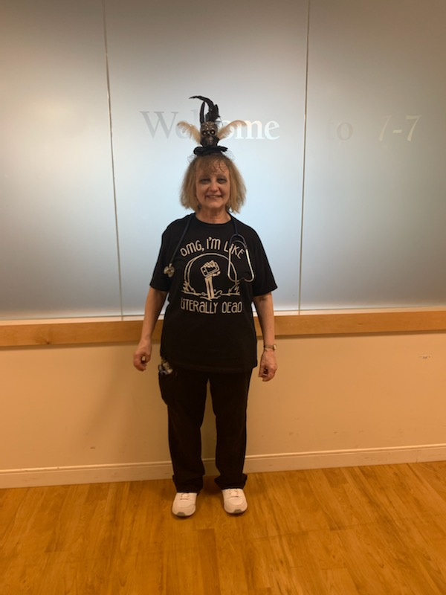
7-7 - SF

Slide 41
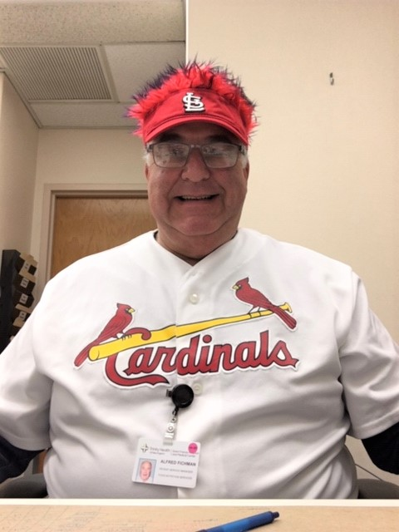
Food & Nutrition - SF

Slide 42
Engineering - SF

Slide 43
ED - SF

Slide 44
CWHC - SF

Slide 45
General Surgery - SF

Slide 46
Spiritual Care - SF

Slide 47
Interventional Cardiology - SF

Slide 48
Patient Access - SF

Slide 49
UroGyn

Slide 50
Case Management - SF

Slide 51
Radiology Ultrasound - SF

Slide 52
CJRI - SF

Slide 53
Automated Data Lab - SF

Slide 54
Mount Sinai Individuals

Slide 55
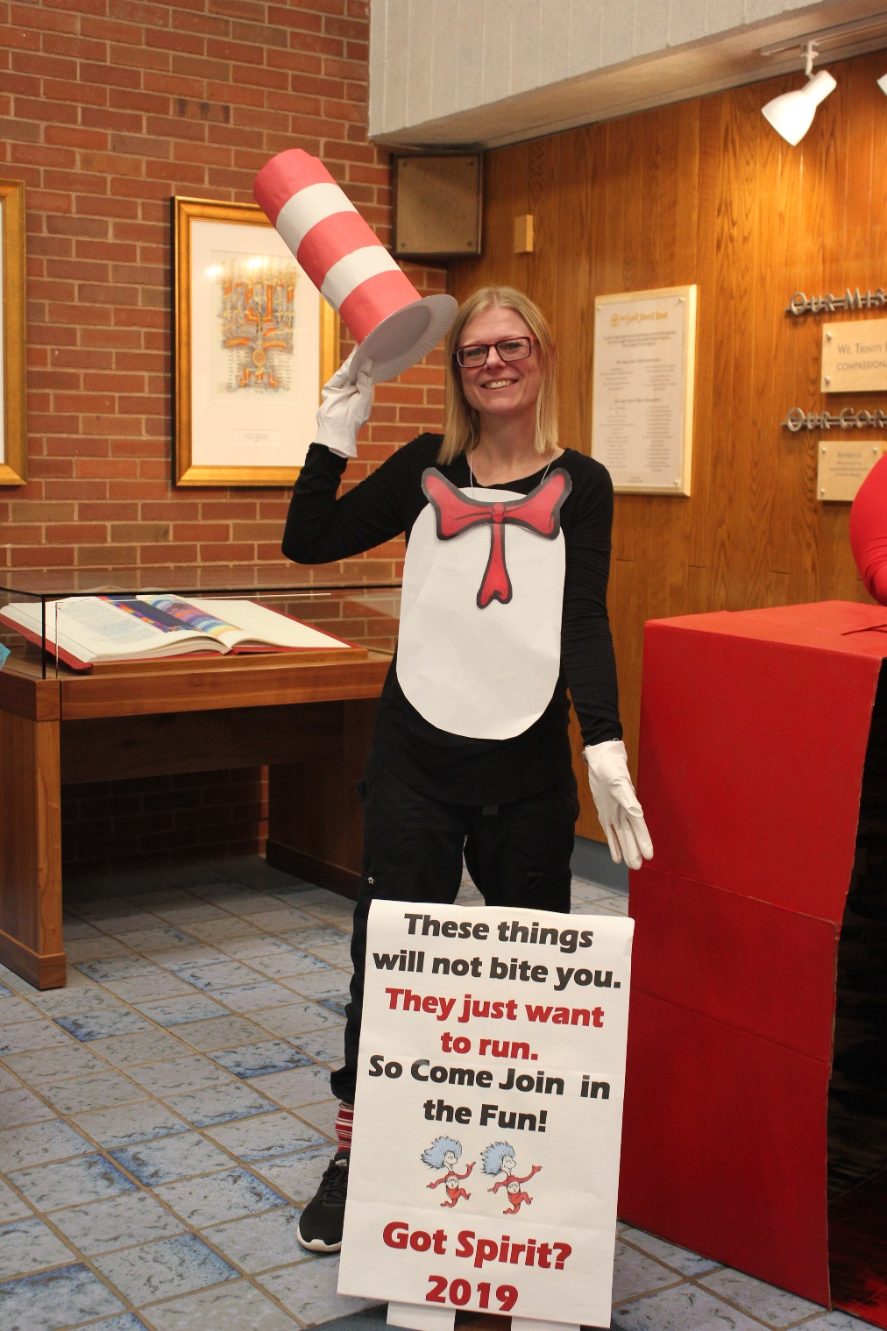
Behavioral Health - MS

Slide 56
Mandell MS Center- MS

Slide 57
Rehab Tech - MS

Slide 58
Johnson Memorial Individuals

Slide 59
Diagnostic Imaging

Slide 60
Patient Access - JMH

Slide 61
HR - JMH

Slide 62
Quality - JMH

Slide 63
Patient Access - JMH

Slide 64
Other Sites

Slide 65
Torrington

Slide 66
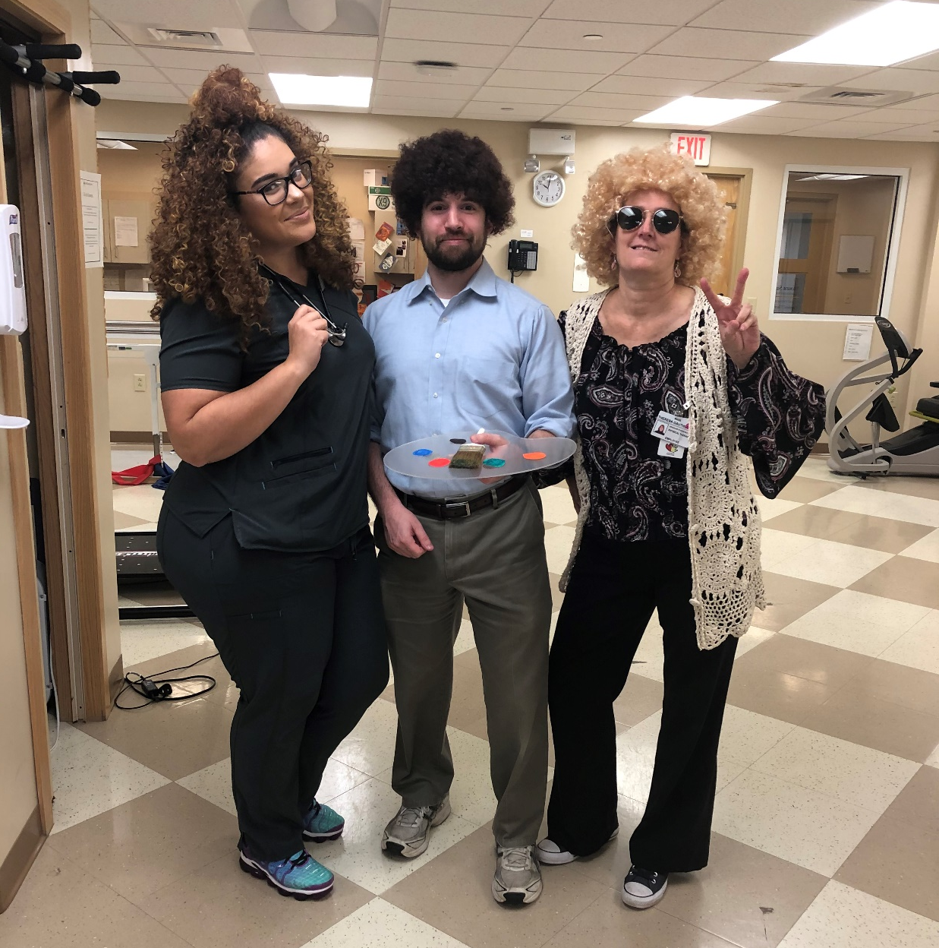
JCC PT Colleagues

Slide 67
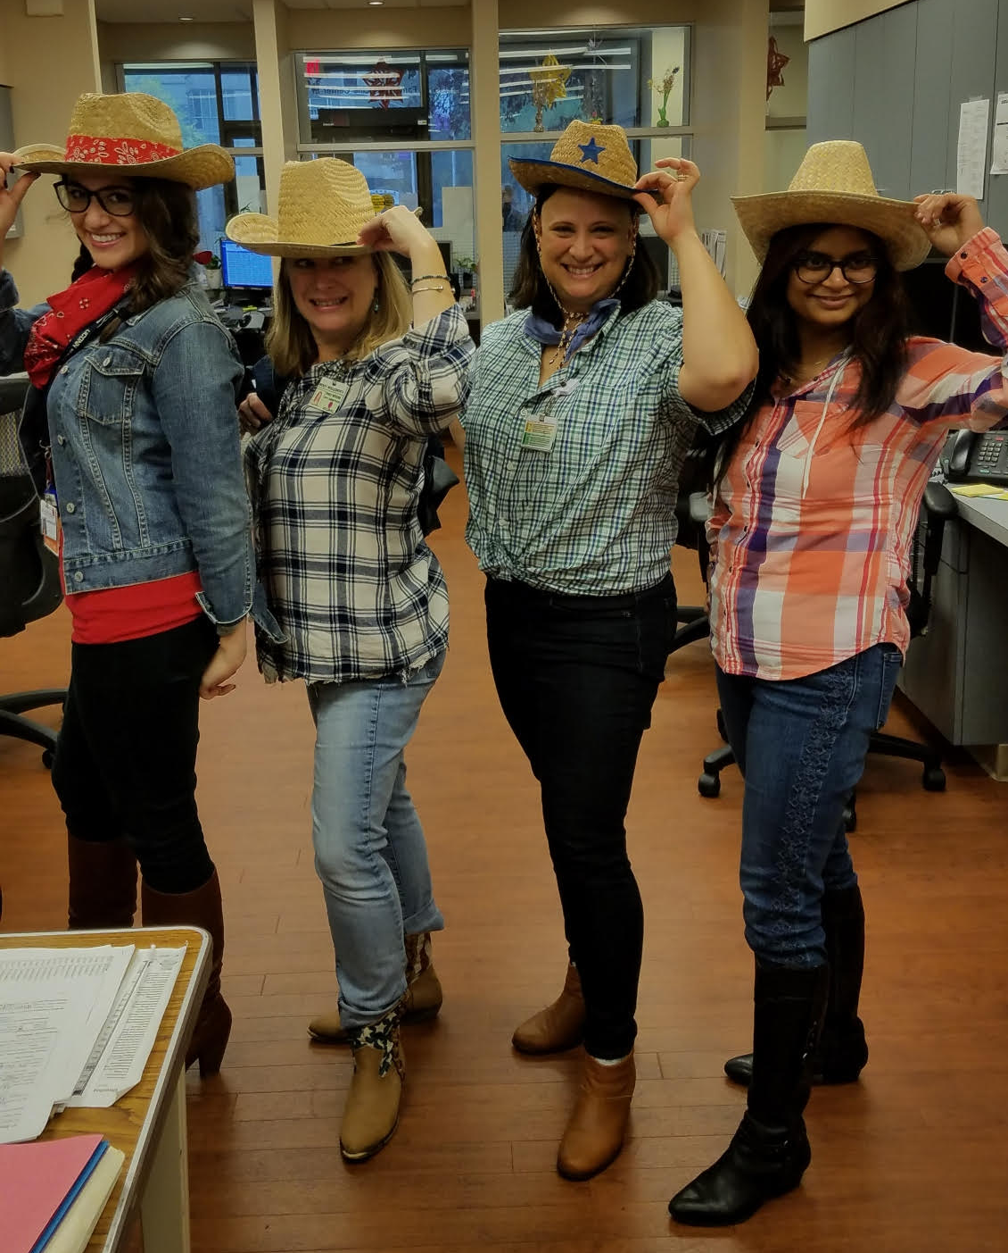
Family Medicine

Slide 68
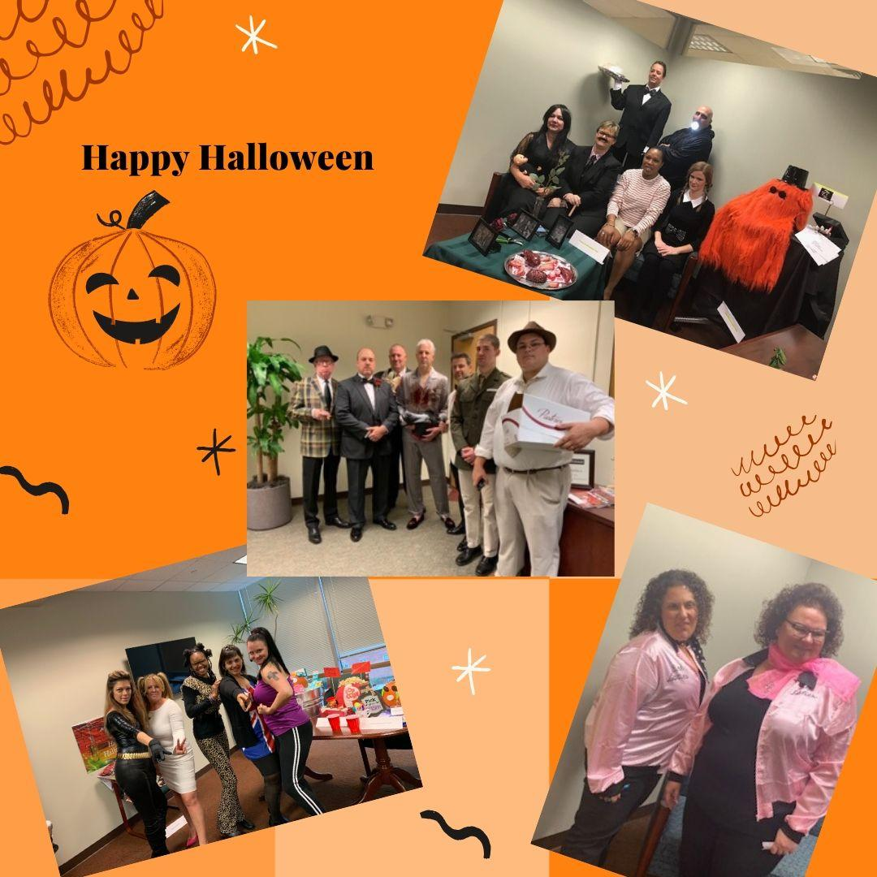
SFHCP

